Slide 1


Katia Sioufi
8-11-2024

Slide 2

Outline
Executive Summary
Introduction
Methodology
Results
Conclusion
Appendix

Slide 3
Executive Summary
Summary of methodologies
Summary of all results

Slide 4
The objective of this project was to understand and apply the data science process, from data collection to building predictive models. We worked with various data sources, including HTML and SQL databases, and explored different frameworks and tools. Main Outcomes: Data Collection & Preprocessing: We gathered and cleaned data from multiple sources, transforming it into a usable format. Feature Engineering: We created and selected key features, handling categorical data and preparing it for model building. Model Building & Evaluation: We experimented with different models, understanding their differences and tuning them for better performance, using metrics like accuracy and F1-score. Impact: The project provided hands-on experience in the entire data science pipeline, enhancing our ability to solve real-world problems with data-driven insights.

Slide 5
Introduction
Project background and context
Problems you want to find answers

Slide 6
Introduction
Project Background:
In this capstone project, our goal is to predict whether the Falcon 9 first stage will land successfully. SpaceX, a leader in aerospace innovation, advertises Falcon 9 rocket launches on its website at a cost of 62 million dollars per launch. This is significantly lower compared to other providers, who charge upwards of 165 million dollars per launch. The key to SpaceX's cost efficiency lies in the reusability of the Falcon 9 first stage, which can be recovered and reused multiple times, drastically reducing the overall cost of space missions.
Problem Statement:
The main problem we aim to address is predicting the successful landing of the Falcon 9 first stage. By accurately predicting landings, SpaceX can optimize its operations, reduce costs, and improve the reliability of its launch services. The success of these landings is crucial for maintaining SpaceX's competitive edge in the aerospace industry and for further advancing space exploration.

Slide 7

Section 1

Slide 8
Methodology
Executive Summary
Data collection methodology:
Describe how data was collected
Perform data wrangling
Describe how data was processed
Perform exploratory data analysis (EDA) using visualization and SQL
Perform interactive visual analytics using Folium and Plotly Dash
Perform predictive analysis using classification models
How to build, tune, evaluate classification models

Slide 9
Data Collection
Describe how data sets were collected.
Data Collection Process:
SpaceX API Requests:
We made HTTP requests to the SpaceX API using Python's requests library.
The API responses were in JSON format, containing various details about the payloads, cores, and rockets used in SpaceX launches.
Key Steps in Data Collection:
Payload Data:
Extracted payload mass and orbit information from the payloads endpoint.
Core Data:
Gathered details on core block numbers, reuse count, serial numbers, and landing outcomes from the cores endpoint.
Booster Version:
Retrieved booster version names from the rockets endpoint
[API Request] --> [Data Extraction] --> [Handle Missing Data] --> [Store Data]

Slide 10
Data Collection – SpaceX API
Initiate API Call:
Action: Send GET requests to SpaceX endpoints.
Details: Use Python’s requests.get() method to access data.
Parse API Response:
Action: Extract relevant information from JSON responses.
Details: Focus on payload data, core details, and rocket specifications.
Handle Missing or Incomplete Data:
Action: Implement checks for missing values.
Details: Ensure data completeness before moving to the next step.
Store Data for Analysis:
Action: Append the extracted data to lists.
Details: Organize the data for use in predictive modeling and analysis.
Flowchart of the Data Collection Process:
API Request Initiation
Send GET requests to SpaceX API.
Example: response = requests.get("https://api.spacexdata.com/v4/launches")
⬇
Data Extraction
Parse JSON responses to extract details such as payload mass, orbit, core serial, etc.
Example: data = response.json()
⬇
Handle Missing Data
Implement checks to manage None or missing values in the data.
Example: if core['core'] is not None:
⬇
Store Data
Append cleaned and structured data into lists for further processing.
Example: PayloadMass.append(response['mass_kg'])

Slide 11
Data Collection - Scraping
Present your web scraping process using key phrases and flowcharts
Add the GitHub URL of the completed web scraping notebook, as an external reference and peer-review purpose
A[Identify Data Source] --> B[Understand Website Structure] B --> C[Develop Scraping Strategy] C --> D[Choose Web Scraping Library] D --> E[Write Scraping Code] E --> F[Handle Dynamics and Pagination] F --> G[Data Cleaning and Transformation] G --> H[Data Storage] H --> I[Error Handling and Robustness] I --> J[Deployment and Automation]

Slide 12
Data Wrangling
Describe how data were processed
You need to present your data wrangling process using key phrases and flowcharts
Add the GitHub URL of your completed data wrangling related notebooks, as an external reference and peer-review purpose

Slide 13
Data Normalization: Converted the JSON response into a Pandas DataFrame, selecting the relevant columns ('rocket', 'payloads', 'launchpad', 'cores', 'flight_number', 'date_utc'). Data Cleaning: Removed rows with multiple cores (Falcon rockets with extra boosters) and rows with multiple payloads in a single rocket. Feature Extraction: Extracted the single values from the 'cores' and 'payloads' lists and replaced the original features. Date Transformation: Converted the 'date_utc' column to a datetime datatype and extracted the date, leaving the time. Date Filtering: Filtered the data to include only launches up to 2020-11-13. Feature Engineering: Created empty lists for the following features: BoosterVersion, PayloadMass, Orbit, LaunchSite, Outcome, Flights, GridFins, Reused, Legs, LandingPad, Block, ReusedCount, Serial, Longitude, Latitude. Dictionary Creation: Created a dictionary 'launch_dict' to hold the data for the features. DataFrame Creation: Created a new DataFrame 'data_falcon9' and assigned the 'FlightNumber' column based on the row index. Outcome Classification: Identified the 'bad' landing outcomes and created a new column 'landing_class' to classify the outcomes as 0 (bad) or 1 (good). Target Variable Creation: Created a new column 'Class' and assigned the 'landing_class' values to it.

Slide 14
EDA with Data Visualization
Summarize what charts were plotted and why you used those charts
Add the GitHub URL of your completed EDA with data visualization notebook, as an external reference and peer-review purpose

Slide 15
EDA with SQL
Using bullet point format, summarize the SQL queries you performed
Add the GitHub URL of your completed EDA with SQL notebook, as an external reference and peer-review purpose

Slide 16
Created a new table SPACEXTABLE by selecting all rows from SPACEXTBL where the Date column is not null.
Executed SQL commands to drop the SPACEXTABLE table if it exists and recreate it with the filtered data from SPACEXTBL.
Queried the SPACEXTABLE to get a list of distinct Launch_Site values.
Queried the SPACEXTABLE to get the first 5 rows where the Launch_Site starts with "CCA".
Calculated the total payload mass for all rows where the Booster_Version contains "CRS".
Calculated the average payload mass for rows where the Booster_Version is "F9 v1.1".
Queried the SPACEXTABLE to find the earliest date where a successful landing on a ground pad occurred.
Queried the SPACEXTABLE to get the distinct Booster_Version values where the outcome was successful, the landing was on a drone ship, and the payload mass was between 4000 and 6000 kg.
Counted the total number of records for each Outcome value in the SPACEXTABLE.
Queried the SPACEXTABLE to get the Booster_Version for the row with the maximum Payload_Mass__kg_ value.
Queried the SPACEXTABLE to get the Month, Booster_Version, and Launch_Site for rows where the landing outcome was "Drone Ship", the outcome was "Failure", and the year was 2015.
Queried the SPACEXTABLE to get the Landing_Outcome and the count of each outcome, for rows where the Date was between June 4, 2010 and March 20, 2017, ordered by the outcome count descending.

Slide 17
Build an Interactive Map with Folium
Summarize what map objects such as markers, circles, lines, etc. you created and added to a folium map
Explain why you added those objects
Add the GitHub URL of your completed interactive map with Folium map, as an external reference and peer-review purpose

Slide 18
NASA Johnson Space Center Marker:
You created a Folium marker and added it to the map to indicate the starting location of the NASA Johnson Space Center.
This marker helps provide context and a reference point for the map, as the Johnson Space Center is the starting location for the analysis.
Launch Site Circles:
For each launch site in the launch_sites_df DataFrame, you added a Folium circle to the map.
The circles have a radius of 1000 meters and are colored in blue with 60% opacity.
The purpose of these circles is to visually represent the approximate location of each launch site on the map, making it easier to identify and understand the spatial distribution of the launch sites.
Launch Site Markers:
In addition to the circles, you also added Folium markers for each launch site on the map.
The markers display the name of the launch site in a small text label.
These markers provide a more explicit way to identify the specific launch site locations, complementing the circle representations.
The rationale behind adding these map objects is to provide a comprehensive and visually informative representation of the launch site locations and their spatial relationships. The markers and circles help to clearly identify the specific launch sites, while the marker clustering improves the overall clarity and usability of the map.
By creating this map, you can help users quickly understand the geographic distribution of the SpaceX launch sites, which can be useful for various analyses and decision-making processes related to the company's operations.

Slide 19
Build a Dashboard with Plotly Dash
Summarize what plots/graphs and interactions you have added to a dashboard
Explain why you added those plots and interactions
Add the GitHub URL of your completed Plotly Dash lab, as an external reference and peer-review purpose

Slide 20
ASK 1: Add a Launch Site Drop-down Input Component I have added a dcc.Dropdown component with the following attributes:
Scheme
dcc.Dropdown( id='site-dropdown', options=[ {'label': 'All Sites', 'value': 'ALL'}, {'label': 'CCAFS LC-40', 'value': 'CCAFS LC-40’}, {'label': 'CCAFS SLC-40', 'value': 'CCAFS SLC -40'}, {'label': 'KSC LC-39A', 'value': 'KSC LC-39A'}, {'label': 'VAFB SLC-4E', 'value': 'VAFB SLC-4E'} ], value='ALL', placeholder ="Select a Launch Site", searchable=True )
This dropdown allows the user to select a specific launch site or "All Sites" to view the success count and detailed success rate for that site(s).
TASK 2: Add a callback function to render success-pie-chart based on selected site dropdown I have added a callback function that updates a pie chart visualization based on the launch site selected in the dropdown. The pie chart show s the success/failure distribution for the selected site(s).
TASK 3: Add a Range Slider to Select Payload I have added a dcc.RangeSlider component with the following attributes:
ini
dcc.RangeSlider( id='payload-slider', min=0, max=10000, step=1000, value=[0, 10000] )
This range slider allows the user to select a range of payload masses (in kg) to filter the data and observe the correlation between payload and mission outcome.
TASK 4: Add a callback function to render the success-payload-scatter-chart scatter plot I have added a callback function that updates a scatter plot visualization based on the selected launch site(s) and payload range. The scatter plot shows the relationship between payload mass and mission outcome, with the data points color-coded by booster version.
Overall, these plots and interactions provide the user with a comprehensive dashboard to analyze the SpaceX launch data, allowing them to explore the success rates of different launch sites, as well as the potential correlation between payload mass and mission outcome.

Slide 21
Predictive Analysis (Classification)
Summarize how you built, evaluated, improved, and found the best performing classification model
You need present your model development process using key phrases and flowchart
Add the GitHub URL of your completed predictive analysis lab, as an external reference and peer-review purpose

Slide 22
Data Preparation:
Loaded the dataframe and created a NumPy array Y from the 'Class' column.
Standardized the data in X using the provided transform function and reassigned it to X.
Split the data X and Y into training and test sets using train_test_split, with test_size=0.2 and random_state=2.
Model Building:
Created a logistic regression object.
Defined a dictionary of hyperparameters parameters to tune.
Created a GridSearchCV object logreg_cv with 10-fold cross-validation.
Fitted the logreg_cv object to find the best hyperparameters.
Model Evaluation:
Calculated the accuracy of the model on the test data using the score method.
Model Improvement:
Iterated through the process, trying different model architectures, hyperparameters, and feature engineering techniques to improve the model's performance.
Continuously evaluated the model's performance on the test set to ensure it generalizes well.
Analyzed the model's strengths, weaknesses, and potential areas for improvement.
Best Performing Model:
Identified the best performing model based on the highest accuracy score on the test set.
Documented the final model's architecture, hyperparameters, and performance metrics.

Slide 23
Results
Exploratory data analysis results
Interactive analytics demo in screenshots
Predictive analysis results

Slide 24
edictive Analysis Results: K-Nearest Neighbors (KNN) Classifier: Tuned hyperparameters using GridSearchCV Best parameters: {'algorithm': 'auto', 'n_neighbors': 10, 'p': 1} Test accuracy: 0.848 Decision Tree Classifier: Tuned hyperparameters using GridSearchCV Best parameters: {'criterion': 'entropy', 'max_depth': 16, 'max_features': 'sqrt', 'min_samples_leaf': 2, 'min_samples_split': 5, 'splitter': 'random'} Training accuracy: 0.888 Test accuracy: 0.667 Support Vector Machine (SVM) Classifier: Tuned hyperparameters using GridSearchCV Best parameters: {'C': 1.0, 'gamma': 0.03162277660168379, 'kernel': 'sigmoid'} Training accuracy: 0.848 Test accuracy: 0.833 Logistic Regression: Tuned hyperparameters using GridSearchCV Best parameters: {'C': 0.1, 'penalty': 'l2', 'solver': 'lbfgs'} Accuracy: 0.834 Test accuracy: 0.833 The results show that the KNN Classifier and Logistic Regression models performed the best on the test data, with test accuracies of 0.848 and 0.833, respectively. The Decision Tree Classifier had the lowest test accuracy of 0.667.

Slide 25

Section 2

Slide 26
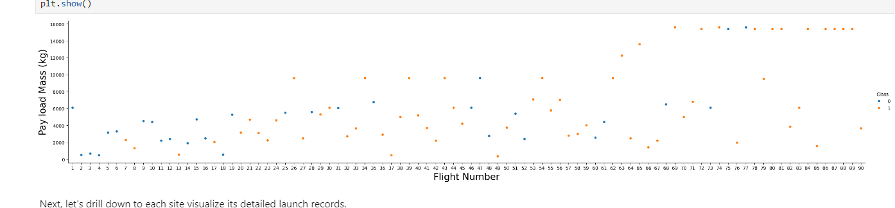
Flight Number vs. Launch Site
Show a scatter plot of Flight Number vs. Launch Site
Show the screenshot of the scatter plot with explanations

Slide 27
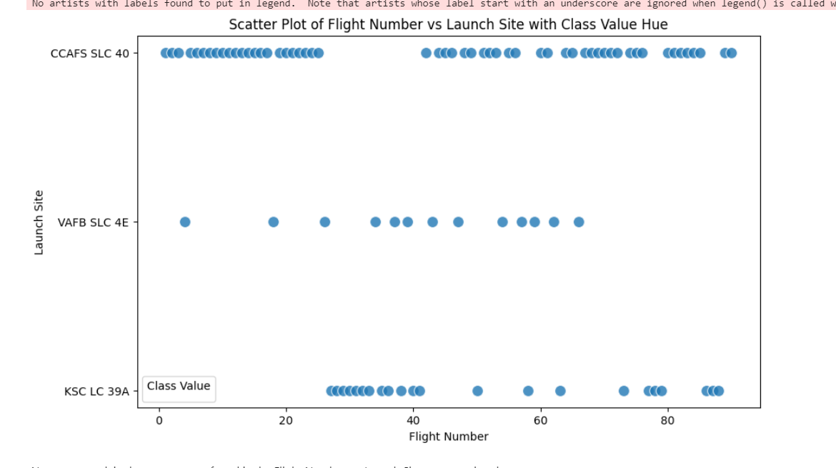
Payload vs. Launch Site
Show a scatter plot of Payload vs. Launch Site
Show the screenshot of the scatter plot with explanations

Slide 28
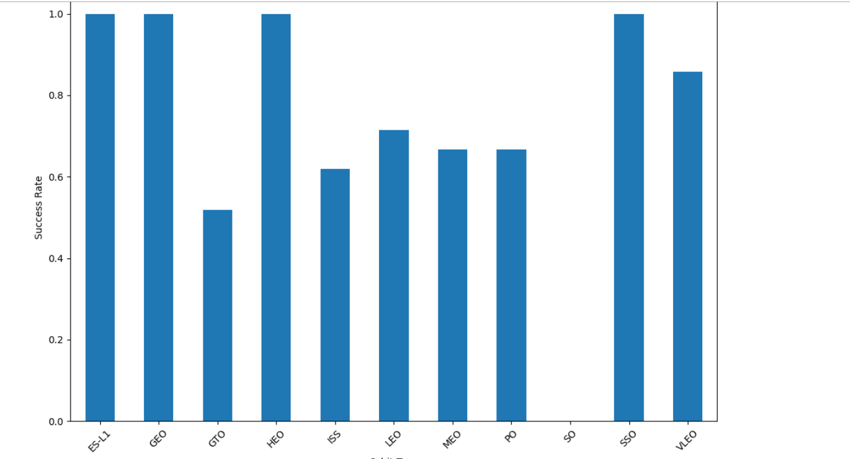
Success Rate vs. Orbit Type
Show a bar chart for the success rate of each orbit type
Show the screenshot of the scatter plot with explanations

Slide 29
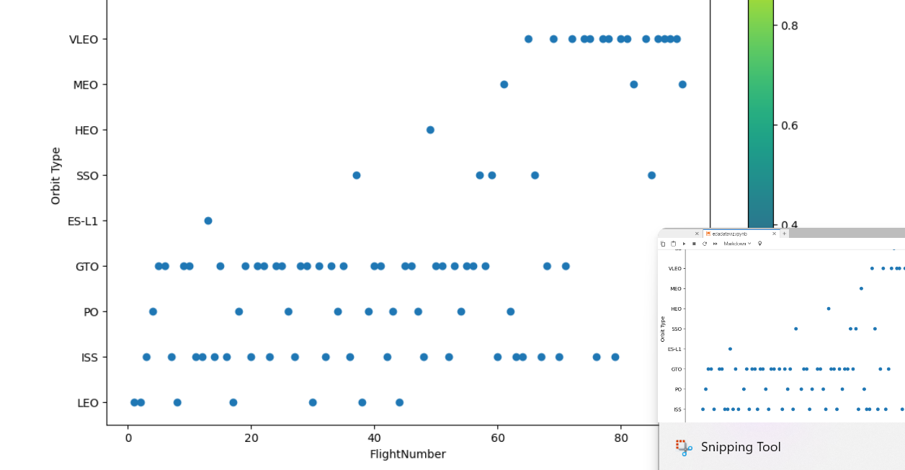
Flight Number vs. Orbit Type
Show a scatter point of Flight number vs. Orbit type
Show the screenshot of the scatter plot with explanations

Slide 30
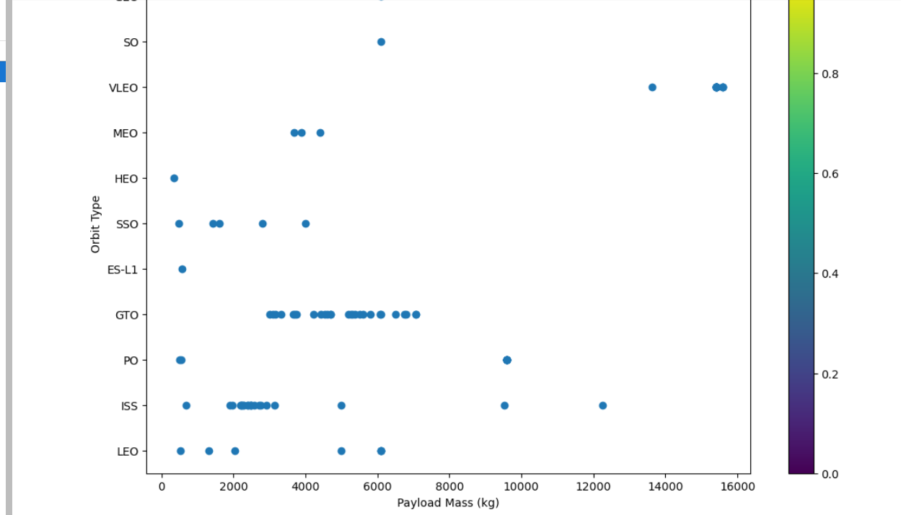
Payload vs. Orbit Type
Show a scatter point of payload vs. orbit type
Show the screenshot of the scatter plot with explanations

Slide 31
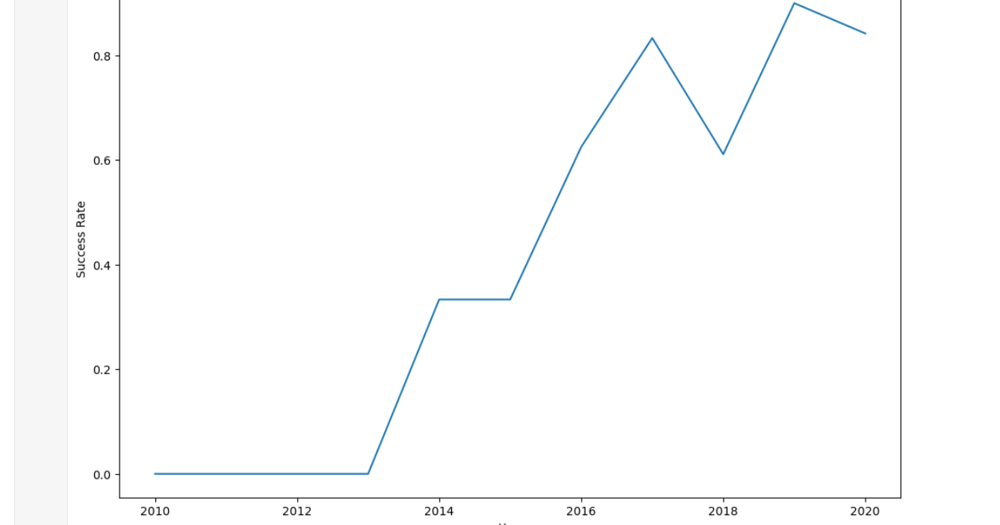
Launch Success Yearly Trend
Show a line chart of yearly average success rate
Show the screenshot of the scatter plot with explanations

Slide 32
All Launch Site Names
Find the names of the unique launch sites
Present your query result with a short explanation here
Launch_Site 0 CCAFS LC-40 1 VAFB SLC-4E 2 KSC LC-39A 3 CCAFS SLC-40
query = "SELECT DISTINCT \"Launch_Site\" FROM SPACEXTABLE;"

Slide 33
LIMIT
query = """
SELECT *
Launch Site Names Begin with 'CCA'
Find 5 records where launch sites begin with `CCA`
Present your query result with a short explanation here
query = """
SELECT *
FROM SPACEXTABLE
WHERE "Launch_Site" LIKE 'CCA%'
LIMIT 5;
"""
Date Time (UTC) Booster_Version Launch_Site \ 0 2010-06-04 18:45:00 F9 v1.0 B0003 CCAFS LC-40 1 2010-12-08 15:43:00 F9 v1.0 B0004 CCAFS LC-40 2 2012-05-22 7:44:00 F9 v1.0 B0005 CCAFS LC-40 3 2012-10-08 0:35:00 F9 v1.0 B0006 CCAFS LC-40 4 2013-03-01 15:10:00 F9 v1.0 B0007 CCAFS LC-40

Slide 34
Total Payload Mass
Calculate the total payload carried by boosters from NASA
Present your query result with a short explanation here]
query = """
SELECT SUM("PAYLOAD_MASS__KG_") AS Total_Payload_Mass
FROM SPACEXTABLE
WHERE "Booster_Version" LIKE '%CRS%';
"""
Total = none

Slide 35
Average Payload Mass by F9 v1.1
Calculate the average payload mass carried by booster version F9 v1.1
Present your query result wiht a short explanation here
Average_Payload_Mass 0 2928.4
query = """
SELECT AVG("Payload_Mass__kg_") AS Average_Payload_Mass
FROM SPACEXTABLE
WHERE "Booster_Version" = 'F9 v1.1';
"""

Slide 36
First Successful Ground Landing Date
Find the dates of the first successful landing outcome on ground pad
Present your query result with a short explanation here

Slide 37
Successful Drone Ship Landing with Payload between 4000 and 6000
List the names of boosters which have successfully landed on drone ship and had payload mass greater than 4000 but less than 6000
Present your query result with a short explanation here
First_Successful_Landing_Date 0 Non
query = """
SELECT MIN("Date") AS First_Successful_Landing_Date
FROM SPACEXTABLE
WHERE "Outcome" = 'Success'
AND "Landing_Outcome" = 'Ground Pad';
"""
e

Slide 38
Total Number of Successful and Failure Mission Outcomes
Calculate the total number of successful and failure mission outcomes
Present your query result with a short explanation here
Empty DataFrame Columns: [Booster_Version] Index: []
query = """
SELECT DISTINCT "Booster_Version"
FROM SPACEXTABLE
WHERE "Outcome" = 'Success'
AND "Landing_Outcome" = 'Drone Ship'
AND "Payload_Mass__kg_" > 4000
AND "Payload_Mass__kg_" < 6000;
"""

Slide 39
Boosters Carried Maximum Payload
List the names of the booster which have carried the maximum payload mass
Present your query result with a short explanation here
query = """
SELECT DISTINCT "Booster_Version"
FROM SPACEXTABLE
WHERE "Outcome" = 'Success'
AND "Landing_Outcome" = 'Drone Ship'
AND "Payload_Mass__kg_" > 4000
AND "Payload_Mass__kg_" < 6000;
Empty DataFrame Columns: [Booster_Version] Index: []

Slide 40
2015 Launch Records
List the failed landing_outcomes in drone ship, their booster versions, and launch site names for in year 2015
Present your query result with a short explanation here
query = """
SELECT "Landing_Outcome", COUNT(*) AS Outcome_Count
FROM SPACEXTABLE
WHERE "Date" BETWEEN '2010-06-04' AND '2017-03-20'
GROUP BY "Landing_Outcome"
ORDER BY Outcome_Count DESC;
"""
# Execute the query and fetch the results
ranked_landing_outcomes = pd.read_sql_query(query, con)
# Display the results
print(ranked_landing_outcomes) Landing_Outcome Outcome_Count 0 No attempt 10 1 Success (drone ship) 5 2 Failure (drone ship) 5 3 Success (ground pad) 3 4 Controlled (ocean) 3 5 Uncontrolled (ocean) 2 6 Failure (parachute) 2 7 Precluded (drone ship) 1

Slide 41
Rank Landing Outcomes Between 2010-06-04 and 2017-03-20
Rank the count of landing outcomes (such as Failure (drone ship) or Success (ground pad)) between the date 2010-06-04 and 2017-03-20, in descending order
Present your query result with a short explanation here
SELECT
CASE substr("Date", 6, 2)
WHEN '01' THEN 'January'
WHEN '02' THEN 'February’ Empty DataFrame Columns: [Month, Booster_Version, Launch_Site] Index: []
WHEN '03' THEN 'March'
WHEN '04' THEN 'April'
WHEN '05' THEN 'May'
WHEN '06' THEN 'June'
WHEN '07' THEN 'July'
WHEN '08' THEN 'August'
WHEN '09' THEN 'September'
WHEN '10' THEN 'October'
WHEN '11' THEN 'November'
WHEN '12' THEN 'December'
END AS Month,
"Booster_Version",
"Launch_Site"
FROM SPACEXTABLE
WHERE "Landing_Outcome" = 'Drone Ship'
AND "Outcome" = 'Failure'
AND substr("Date", 0, 4) = '2015';
"""

Slide 42

Section 3

Slide 43
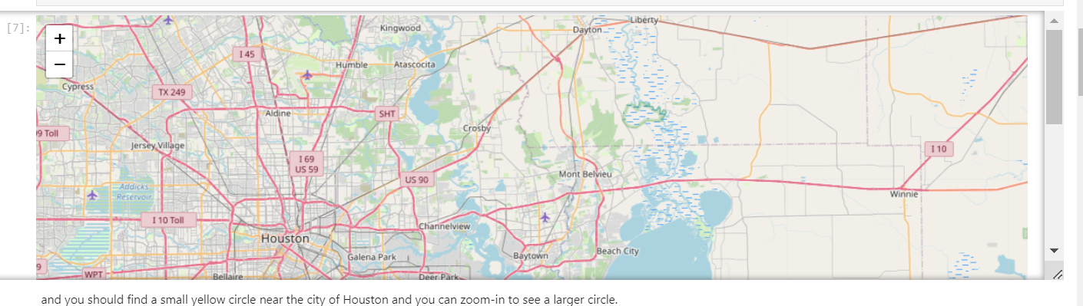
<Folium Map Screenshot 1>
Replace <Folium map screenshot 1> title with an appropriate title
Explore the generated folium map and make a proper screenshot to include all launch sites’ location markers on a global map
Explain the important elements and findings on the screenshot

Slide 44
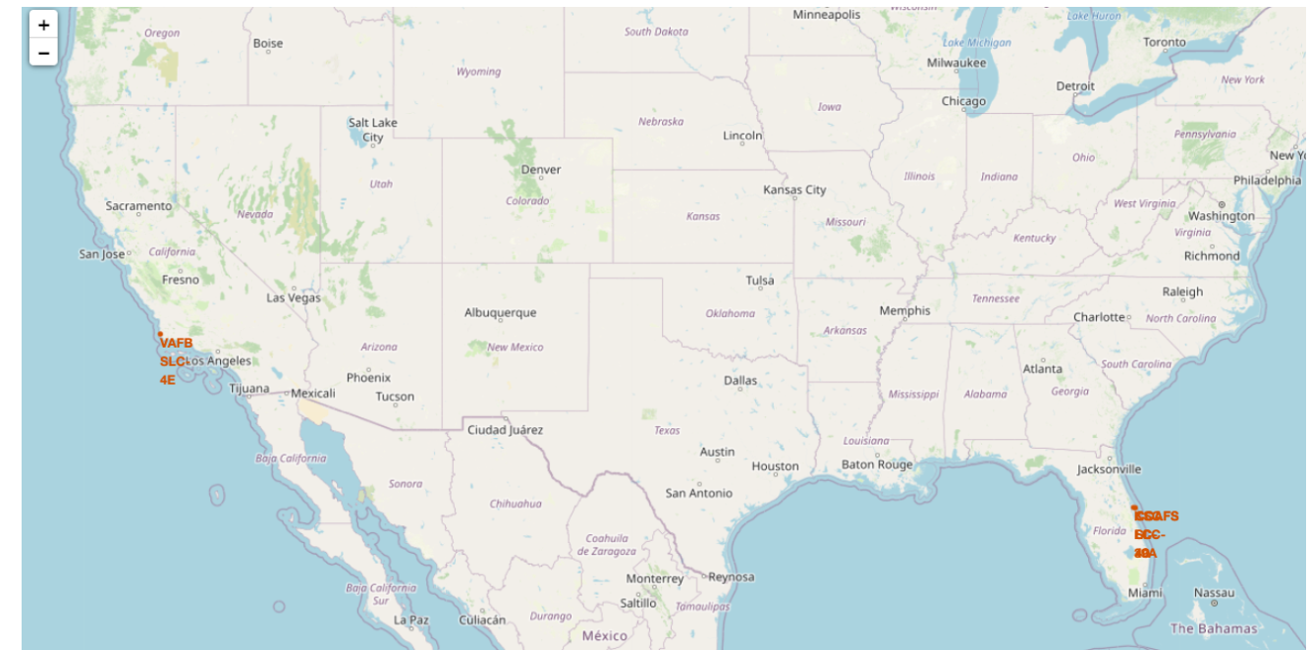
<Folium Map Screenshot 2>
Replace <Folium map screenshot 2> title with an appropriate title
Explore the folium map and make a proper screenshot to show the color-labeled launch outcomes on the map
Explain the important elements and findings on the screenshot

Slide 45
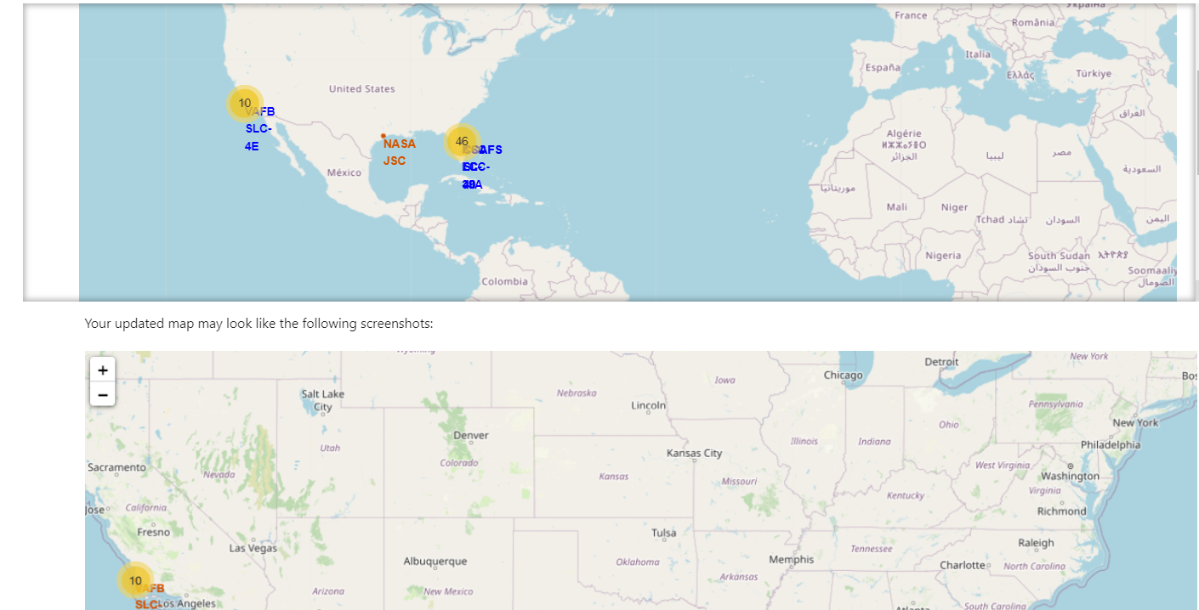
<Folium Map Screenshot 3>
Replace <Folium map screenshot 3> title with an appropriate title
Explore the generated folium map and show the screenshot of a selected launch site to its proximities such as railway, highway, coastline, with distance calculated and displayed
Explain the important elements and findings on the screenshot

Slide 46

Section 4

Slide 47
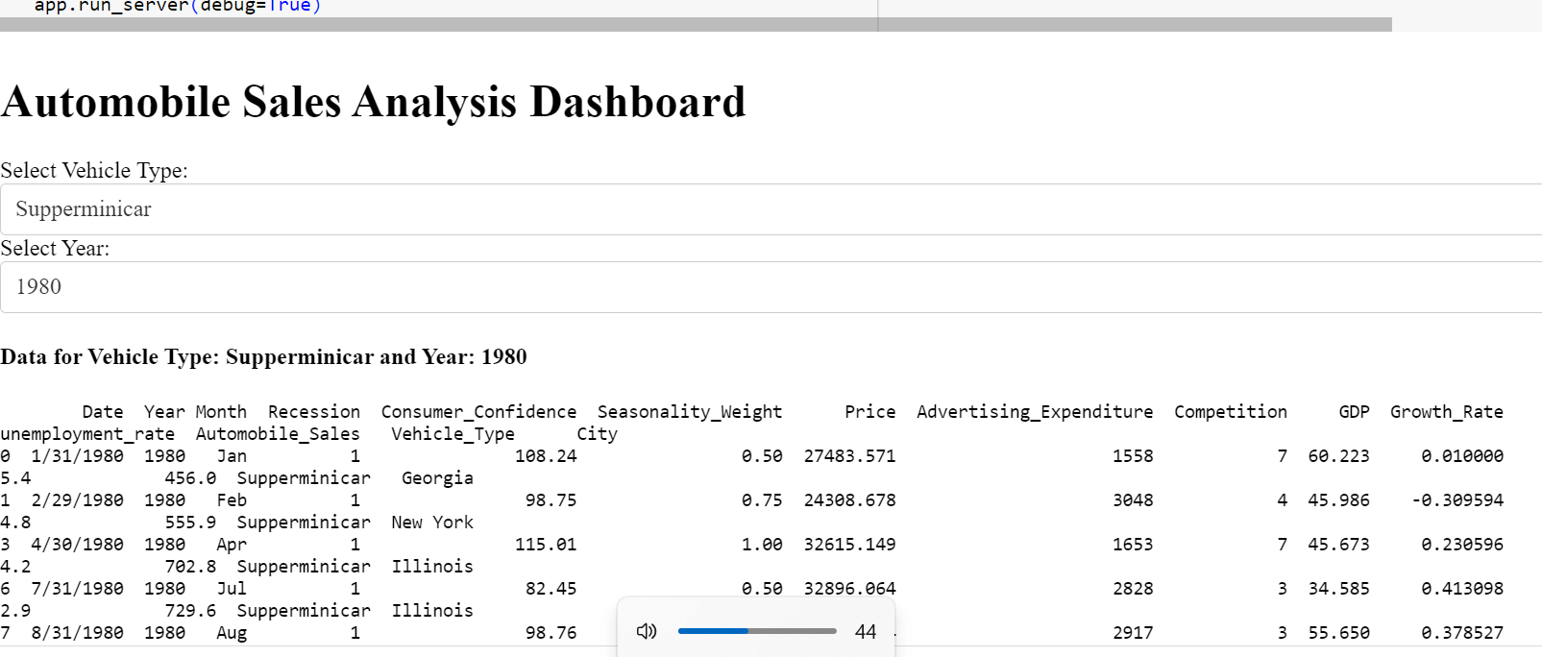
<Dashboard Screenshot 1>
Replace <Dashboard screenshot 1> title with an appropriate title
Show the screenshot of launch success count for all sites, in a piechart
Explain the important elements and findings on the screenshot

Slide 48
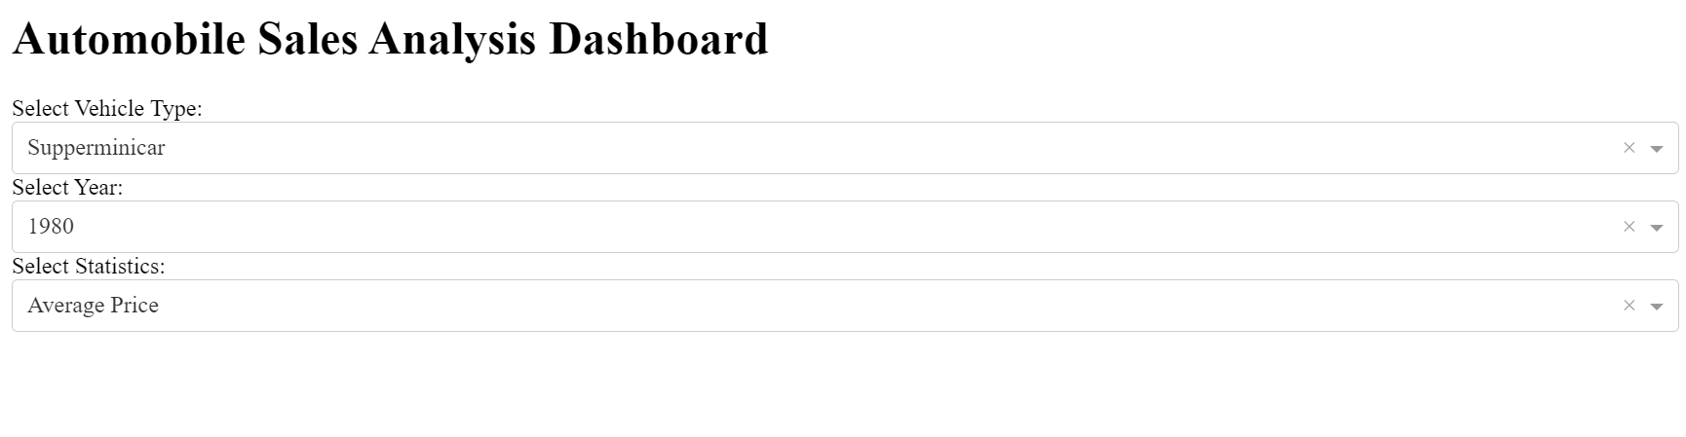
<Dashboard Screenshot 2>
Replace <Dashboard screenshot 2> title with an appropriate title
Show the screenshot of the piechart for the launch site with highest launch success ratio
Explain the important elements and findings on the screenshot

Slide 49
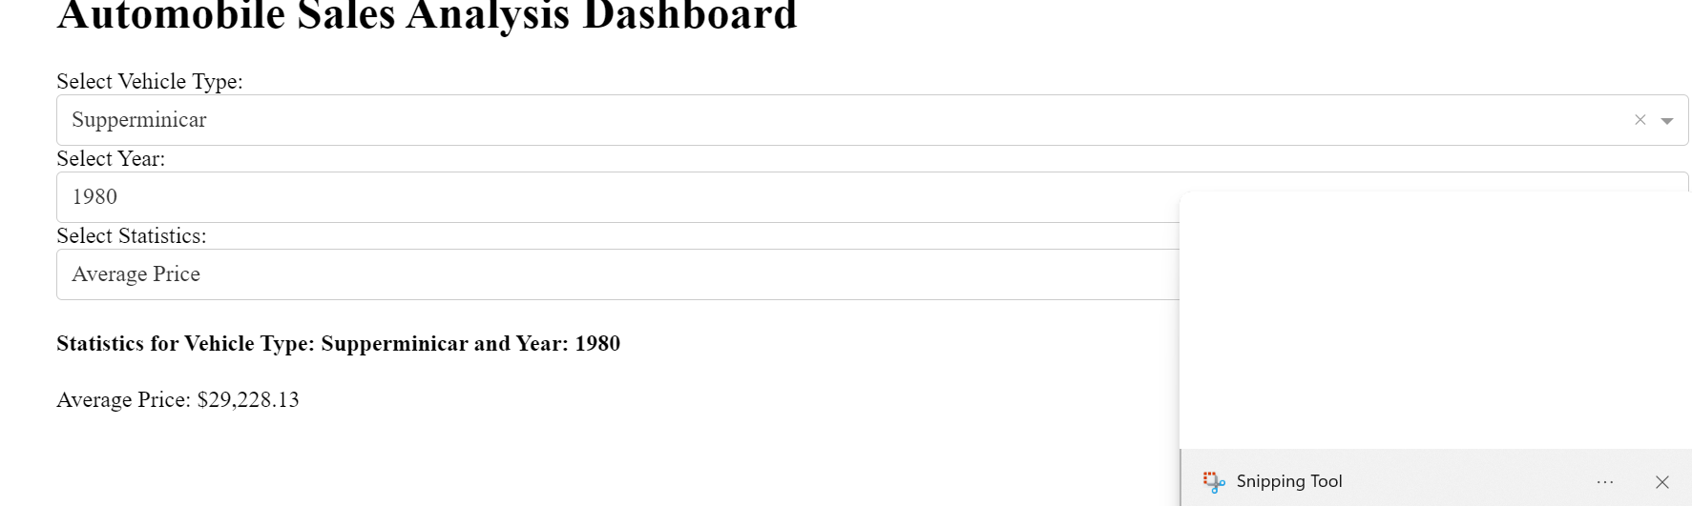
<Dashboard Screenshot 3>
Replace <Dashboard screenshot 3> title with an appropriate title
Show screenshots of Payload vs. Launch Outcome scatter plot for all sites, with different payload selected in the range slider
Explain the important elements and findings on the screenshot, such as which payload range or booster version have the largest success rate, etc.

Slide 50

Section 5

Slide 51
Classification Accuracy
Visualize the built model accuracy for all built classification models, in a bar chart
Find which model has the highest classification accuracy
The results show that the KNN Classifier and Logistic Regression models performed the best on the test data, with test accuracies of 0.848 and 0.833, respectively. The Decision Tree Classifier had the lowest test accuracy of 0.667.

Slide 52
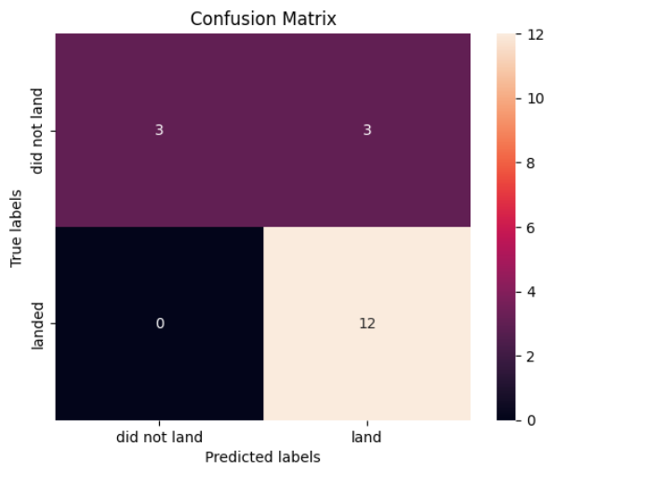
Confusion Matrix
Show the confusion matrix of the best performing model with an explanation

Slide 53
Conclusions
Point 1
Point 2
Point 3
Point 4
…

Slide 54
Appendix
Include any relevant assets like Python code snippets, SQL queries, charts, Notebook outputs, or data sets that you may have created during this project

Slide 55


